Slide 1

MEDIXPERT

Slide 2
TEAM
Ms. JOSMI MATHEW (PROJECT GUIDE)
Mr. ALEX JAMES (PROJECT LEAD)
Mr. LISON SABU (PROJECT BACKEND)
Ms. SOUMYA MATHEW (DESIGN & DOCUMENTATION)
Mr. SURYAJITH R (PROJECT BACKEND)

Slide 3
CONTENTS
ABSTRACT
INTRODUCTION
SYSTEM STUDY
SYSTEM DESIGN
MODULES
ALGORITHM USED
DATASET
STATUS OF THE PROJECT
CONCLUSION
REFFERENCES

Slide 4
ABSTRACT
This is a web application based on ML algorithm. This system help the users to predict the chance of Congestive Heart Failure with a supervised ML algorithm.
Another functionality of this website is that it has the capability to analyze the mental health of the user using some questions and answers.

Slide 5
INTRODUCTION
Roughly 670,000 people are diagnosed with heart failure each year.
Heart failure doesn’t mean the heart has stopped working. Rather, it means that the heart works less efficiently than normal.
Due to various possible causes, blood moves through the heart and body at a slower rate, and pressure in the heart increases.
As a result, the heart can’t pump enough oxygen and nutrients to meet the body's needs.

Slide 6
Main issue regarding this Congestive Heart Failure is that the person did’t know wheather he/she is affected .
To solve this, our system is designed such a way that whether there is a chance of congestive heart failure.
Otherthan this our system has an additional funtionality to analyze the mental health of the users.

Slide 7
SYSTEM STUDY
Hardware Specifications:
Processor Minimum i3 or AMD 3
Minimum 250 MB ROM & 2GB RAM
Software Specifications:
Operating System: Windows 10 or Higher / Linux / Mac
Python (Django) : Minimum Version 3.0 or higher
Xamp / Wamp / Mamp /MySQL/Sqlite
Bootstrap 5 , Html , CSS , JS
Visual Studio Code

Slide 8
SYSTEM DESIGN
As per the current status we have completed the database design and the partial UI designs (Form Designs).
As per the project for the basic functionality we use sqlite database.
The project consist of 4 Tables , They are as follows:
User Table
User_Type
Feedback
Records

Slide 9
SCHEMA DESIGN
Database Name : mediexpert
Table Name: User_type
ATTRIBUTE | TYPE | SIZE
type_id | Int (Primary Key)
type_name | Varchar | 100
status | Int

Slide 10
Table Name: User
ATTRIBUTE | TYPE | SIZE
user_id | Int(Primary Key)
user_name | Varchar | 250
age | Int
email | Varchar | 300
password | Varchar | 250
type_id | Int (Foriegn Key)
status | Int

Slide 11
Table Name: Records
ATTRIBUTE | TYPE | SIZE
rec_id | Int(Primary Key)
rec_name | Varchar | 250
rec_file | Varchar | 300
user_id | Int (Foriegn Key) | 250
status | Int

Slide 12
Table Name: Feedback
ATTRIBUTE | TYPE | SIZE
fed_id | Int (Primary Key)
message | Varchar | 450
user_id | Int(Foriegn Key)
status | Int

Slide 13
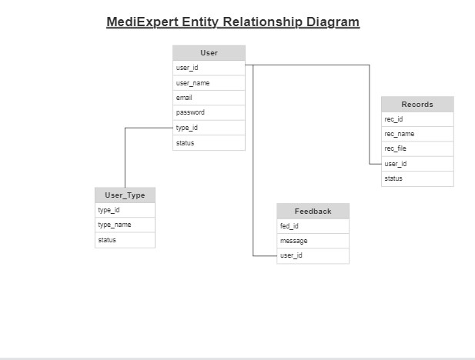
Entity Relationship Diagram

Slide 14
MODULES
ADMIN MODULE
Add/Edit/Delete Doctor
Add/Edit/Delete Lab Technician
Delete Users
View Feedback
USER MODULE
Register as a user
Insert Medical Records
Send Feedback to Admin

Slide 15
ALGORITHM USED
Logistic Regression
Logistic regression estimates the probability of an event occurring, such as voted or didn't vote, based on a given dataset of independent variables. Since the outcome is a probability, the dependent variable is bounded between 0 and 1.
Support Vector Machines
Support Vector Machine(SVM) is a supervised machine learning algorithm used for both classification and regression. Though we say regression problems as well its best suited for classification. The objective of SVM algorithm is to find a hyperplane in an N-dimensional space that distinctly classifies the data points.

Slide 16
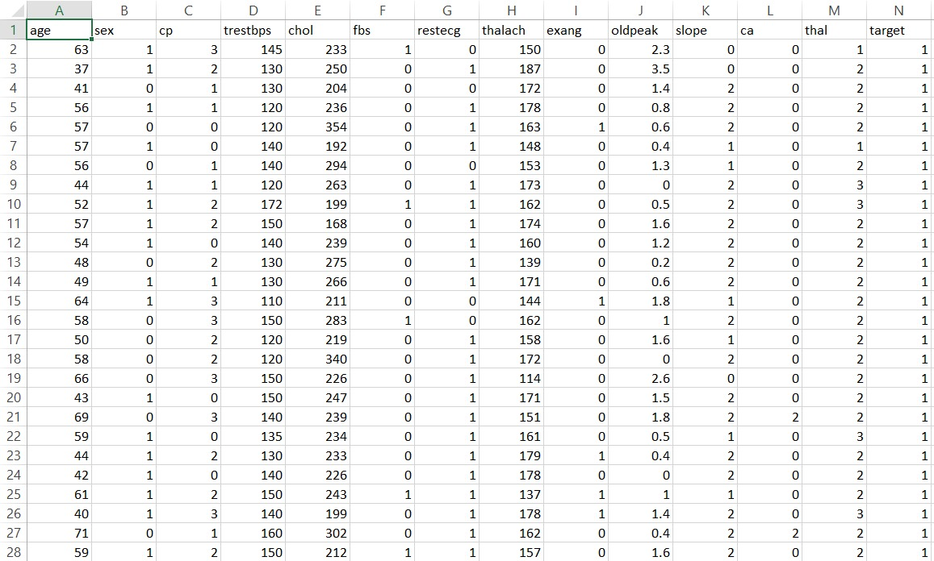
DATASET
Heart Disease Data Set:
The Heart disease data set consists of patient data from Cleveland, Hungary, Long Beach and Switzerland. The combined dataset consists of 14 features and 916 samples with many missing values.

Slide 17
STATUS OF THE PROJECT
System Design on the Subject
(3 WEEKS)
DEVELOPMENT
PHASE 3
(Testing)
System Study on the Subject
(3 WEEKS)
DEVELOPMENT PHASE 2
FINAL
SUBMISSION

Slide 18
CONCLUSION
This Heart Disease detection system assists a patient based on his/her clinical information of them been diagnosed with a previous heart disease.
The algorithms used in building the given model are:
Logistic Regression
Support Vector Machines
It gets 75-80% average binary classification accuracy(heart disease or no heart disease).

Slide 19
REFFERENCE
https://archive.ics.uci.edu/ml/datasets/heart+Disease
https://www.kaggle.com/datasets/andrewmvd/heart-failure-clinical-data
https://www.kaggle.com/discussions/general/188285#1035276

Slide 20
THANKS!

